Slide 1
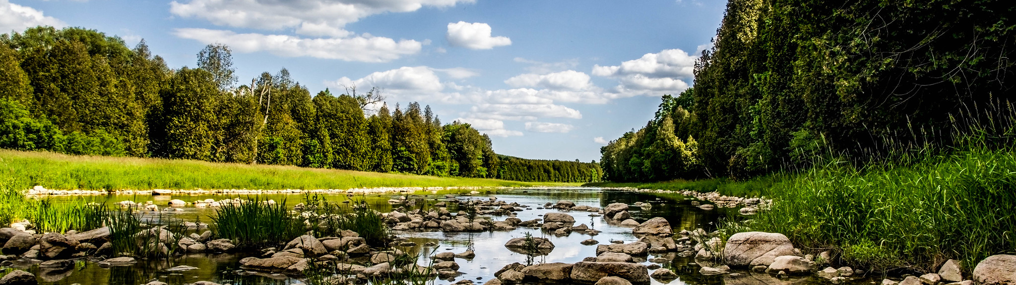
Update to the Long Point Region Source Protection Plan
Public Consultation:
November 10 to December 19, 2025
Photo: Grand River Conservation Authority/S. Hannaford

Slide 2
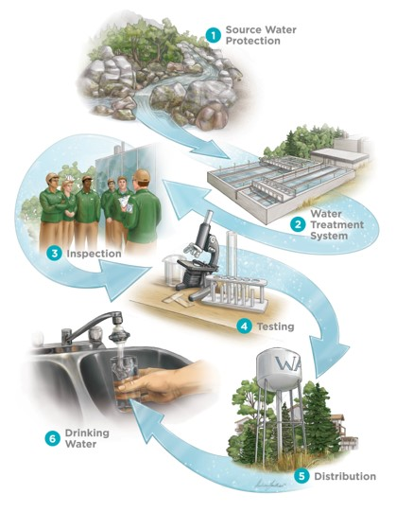
Protecting Drinking Water: What is Source Protection?
The Clean Water Act, 2006 was created in response to the Walkerton Inquiry​.
Source protection is the first barrier in a multi-barrier approach to safeguarding drinking water.
It helps prevent contamination and overuse of municipal drinking water sources​.
Source Protection Plans are developed and implemented to administer this work.

Slide 3

What You Need to Know
Why is the Source Protection Plan being updated?
In response to a Minister’s Order under Section 36 of the Clean Water Act, 2006
To meet current provincial standards and reflect new information.
What is changing?
Updates to technical data, Plan policies, and mapping across affected municipalities.
Who is affected?
Oxford County, Norfolk County, Haldimand County and the Municipality of Bayham in Elgin County.
How to participate:
Review the draft Plan and submit comments online or by mail between November 10 and December 19, 2025

Slide 4
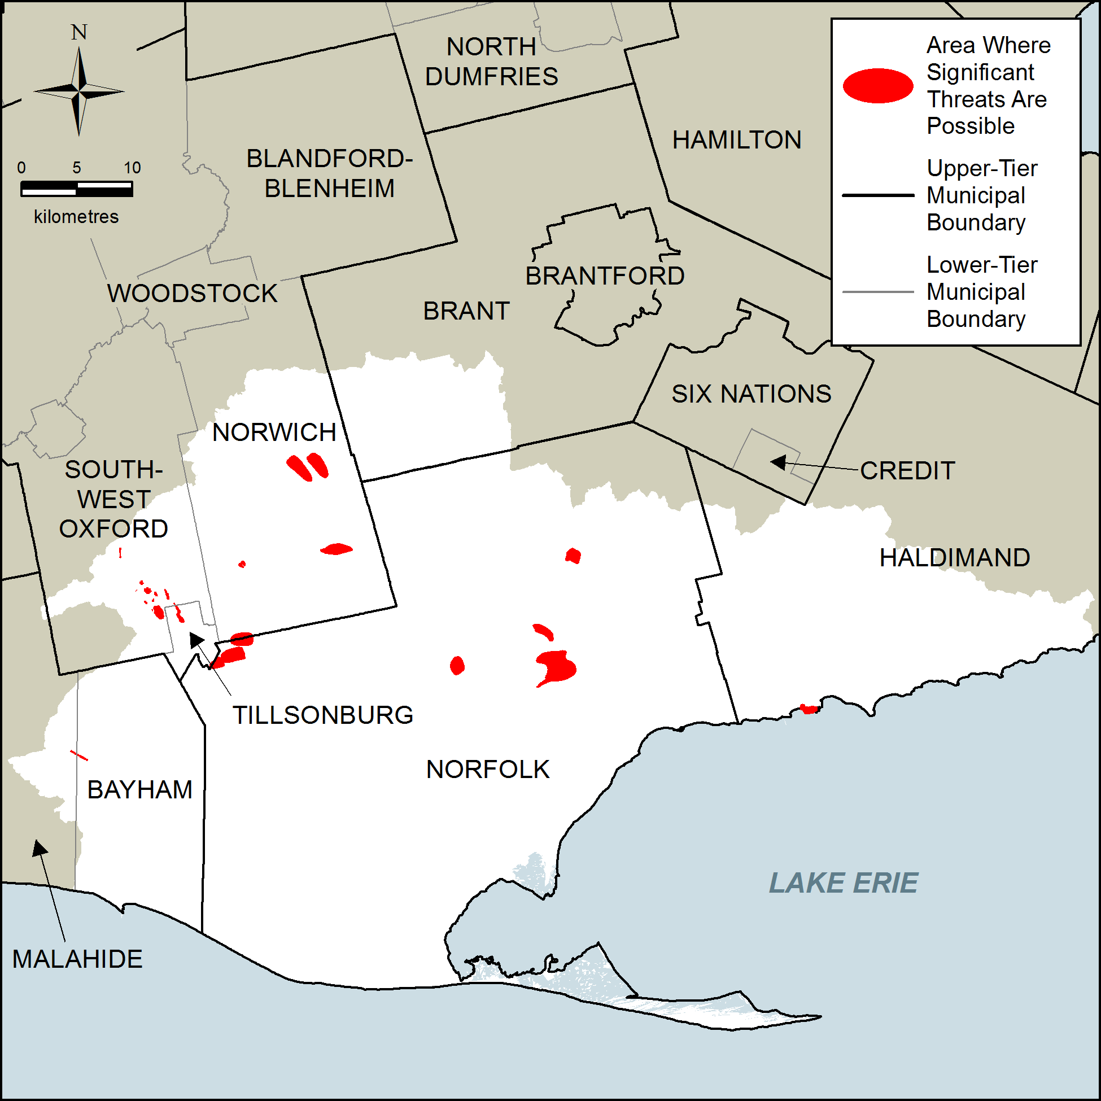
What is a Source Protection Assessment Report?
An Assessment Report provides the technical foundation for the Source Protection Plan.
It identifies risks to municipal drinking water sources, including:
Vulnerable areas; and
Potential threats to water quality and quantity
Threats are ranked as low, moderate or significant.
Existing significant threats are identified in the Assessment Report

Slide 5
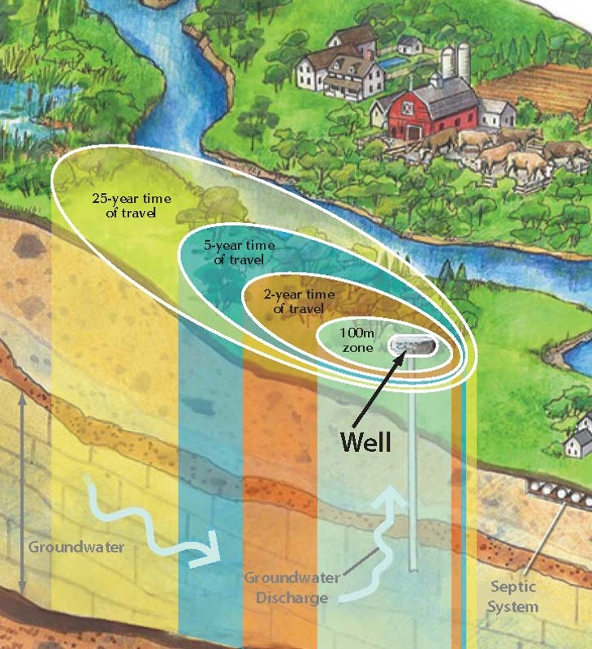
What is a Wellhead Protection Area?
A Wellhead Protection Area (WHPA) is the area around a municipal well that helps protect it from contamination.
The WHPAs are based on “time of travel” which is how long it takes for water to move from the ground surface to the well
WHPA-A (100-metres around the well)
WHPA-B (2 years)
WHPA-C (5 years)
WHPA-D (25 years)

Slide 6
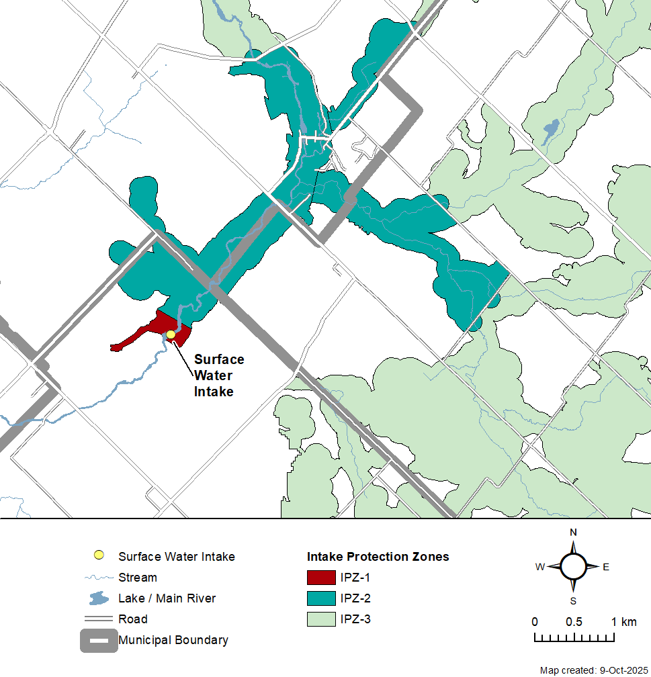
What is an Intake Protection Zone?
An Intake Protection Zone (IPZ) is the area around a municipal intake pipe where the drinking water is supplied from a surface water source.
Zones include:
IPZ-1 (a set distance around the intake pipe)
IPZ-2 (based on a certain length of time it would take contaminants to reach the intake)
IPZ-3 (larger area where contaminants may reach the intake during an extreme event)

Slide 7
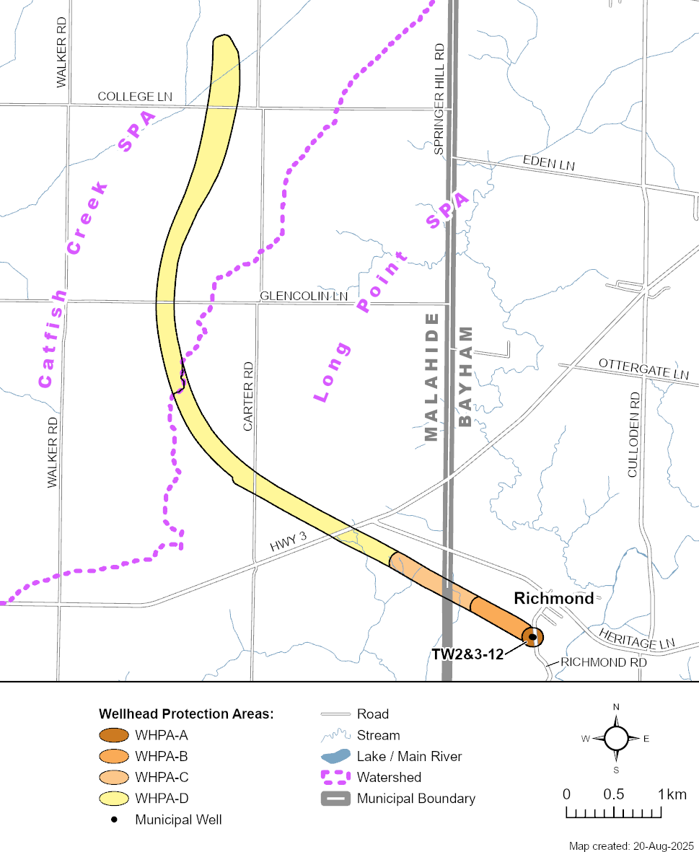
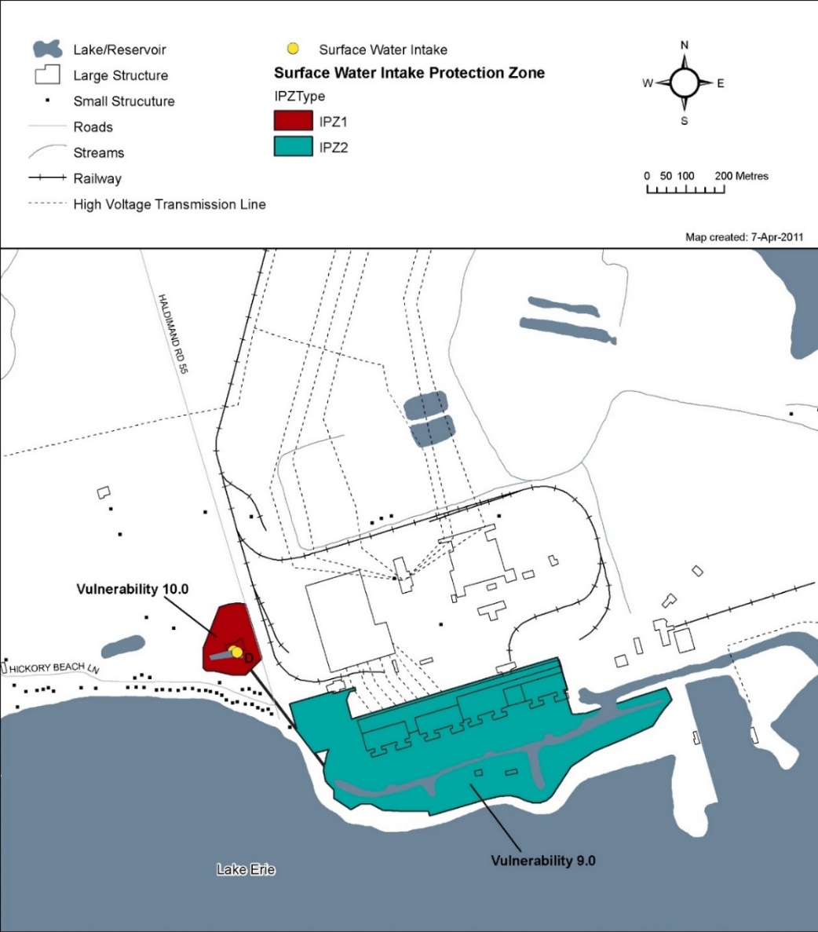
Example WHPA and IPZ in Long Point Region
Richmond Well Supply WHPA in the Municipality of Bayham
Nanticoke Industrial Pump Station IPZ in Haldimand County

Slide 8
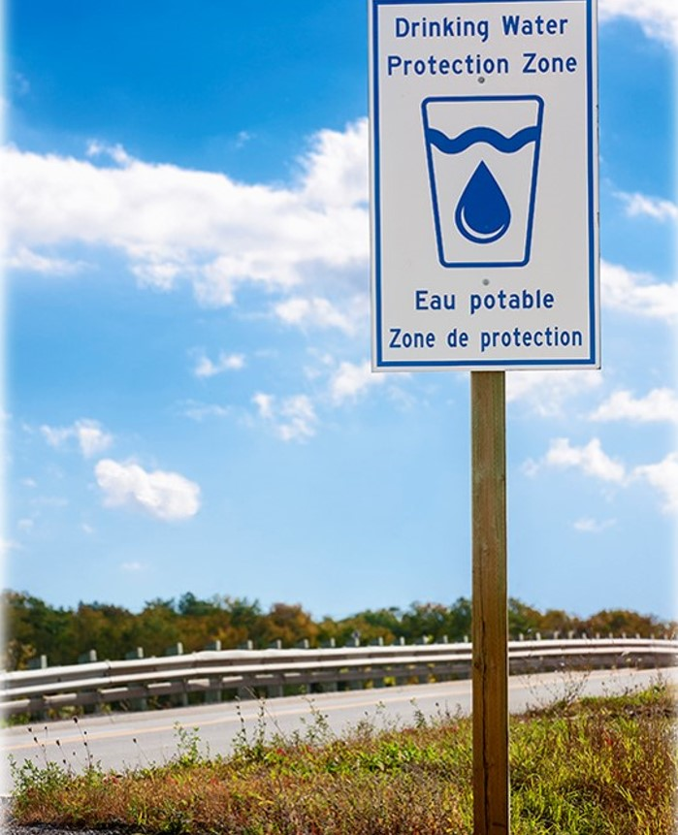
What is a Source Protection Plan?
A Source Protection Plan contains policies that address activities that pose a risk to drinking water
Threat activities are prescribed by the Province through regulation
The threats are classified as significant, moderate, or low
Policies in the Source Protection Plan only apply to significant threats (except for liquid hydrocarbon pipelines)

Slide 9
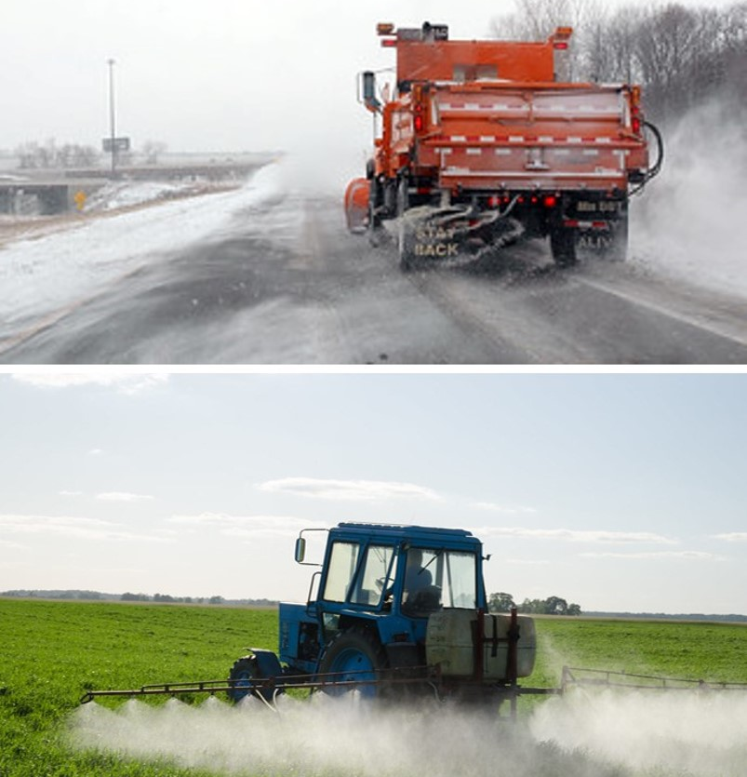
Threats and Policy Tools
Examples of prescribed threats include waste disposal sites, sewage works, fertilizers, pesticides, solvents, road salt, and fuel.
Policy tools for managing these threats include:
Prohibition
Regulation through plans, programs, and approvals
Land use planning
Education and outreach

Slide 10
Long Point Region Assessment Report and Source Protection Plan Updates:

Slide 11
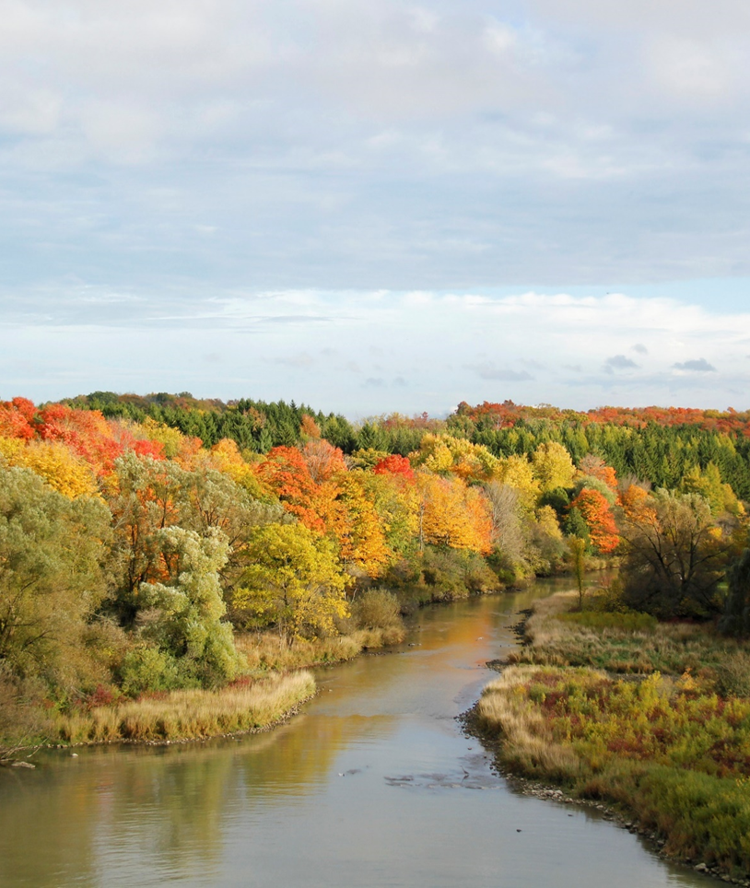
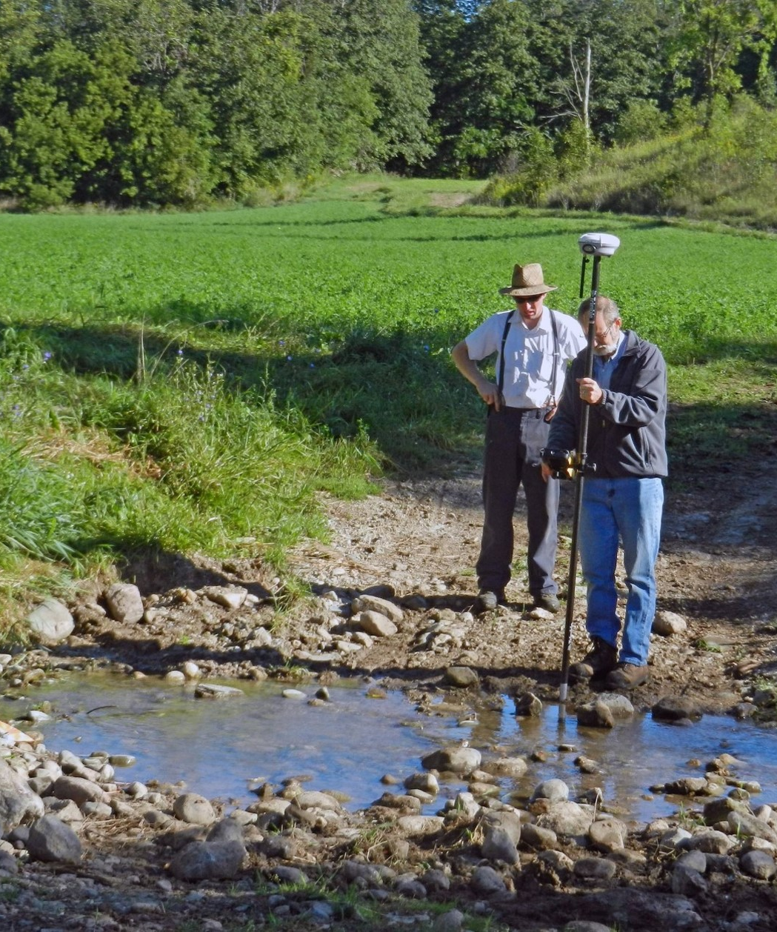
Summary of Assessment Report Updates
Updates to the Assessment Report include:
Updates to how drinking water systems are described
Updated threat assessments based on the most current provincial Technical Rules (2021)
Revised impervious surface categories
Updated methodologies and data for water quality issues

Slide 12

Summary of Assessment Report Updates
Updates to the Assessment
Report (continued):
Terminology updates and table consolidation
Added content on Climate change and Great Lakes agreements
Reformatting of the document to enhance readability

Slide 13
Updated Threat Assessment (2021 Technical Rules)
Oxford
319 identified threat activities across 108 properties
Norfolk
372 identified threat activities across 87 properties
Haldimand
1 identified threat activity on 1 property
Bayham
12 identified threat activities across 5 properties

Slide 14
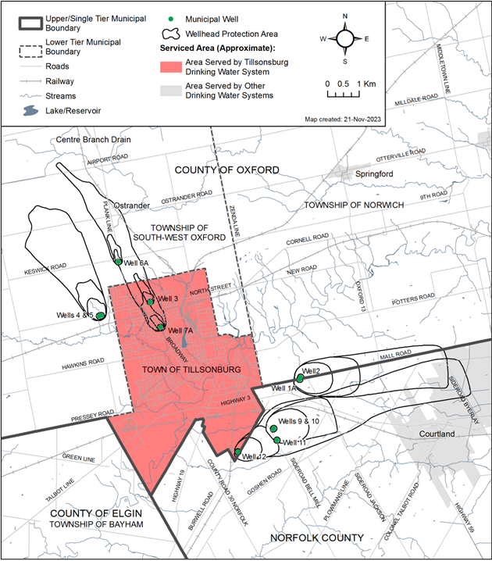
Assessment Report Mapping Updates
Minor updates to reflect current information and smooth area boundaries for clearer interpretation
Non-essential maps removed
Oxford County: Updated map for the Tillsonburg service area
Norfolk County: Smoothing of Simcoe vulnerability map
Municipality of Bayham: Smoothing of Richmond vulnerability map

Slide 15
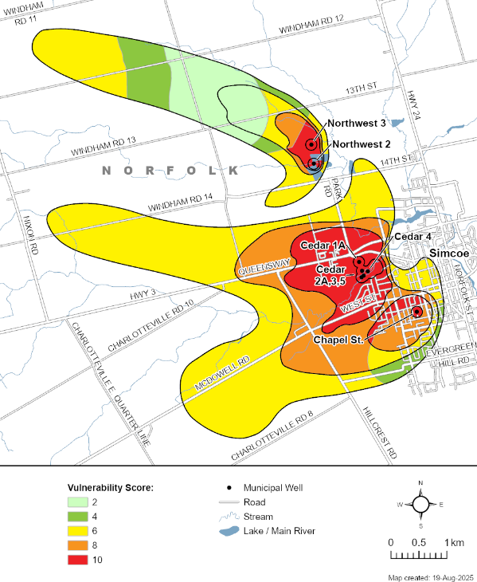
Summary of Source Protection Plan Updates
Key updates to the Source Protection Plan
include:
New or revised policies to conform with current provincial requirements, including:
Using updated threat terminology
Applying policies to the correct vulnerable areas and circumstances
Policy updates to improve implementability and removal of outdated policies
Alignment of policies with provincial regulatory frameworks
For example: agricultural policies better align with how the Nutrient Management Act, 2002 is applied.

Slide 16
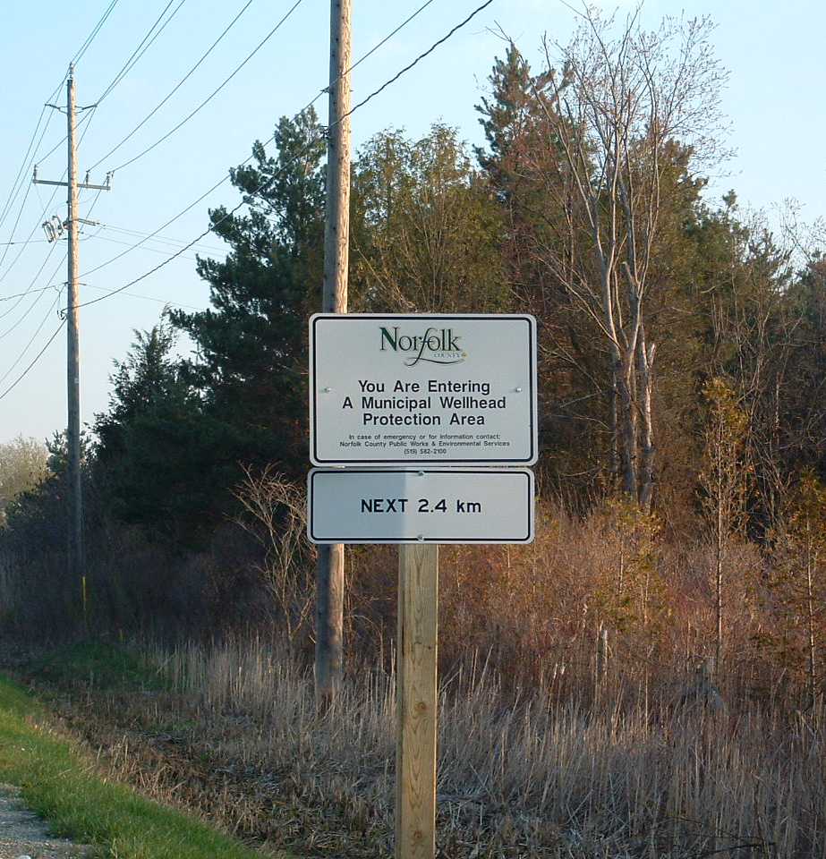
Summary of Source Protection Plan Updates
Key updates to the Source Protection Plan
(continued):
Consistent policy language and structure applied throughout the Plan
Consolidation of policies directed at provincial ministries into fewer policies that apply across Long Point Region
Non-legally binding policies added to address liquid hydrocarbon pipelines
Updated policy rationale in the Explanatory Document
Removal of hard copy maps due to increased use of digital mapping tools

Slide 17
Consultation
View the Draft Plan
The draft Source Protection Plan will be available for review starting Monday, November 10, 2025, online at www.sourcewater.ca and at the following locations:
Grand River Conservation Authority
400 Clyde Road, Cambridge, ON, N1R 5W6
Oxford County
21 Reeve Street, P.O. Box 1614, Woodstock, ON, N4S 7Y3
Norfolk County Planning Department
12 Gilbertson Drive, Simcoe, ON, N3Y 3N3
Haldimand County
53 Thorburn Street South, Cayuga, ON, N0A 1E0
Municipality of Bayham
56169 Heritage Line, PO Box 160, Straffordville, ON, N0J 1Y0

Slide 18
Consultation
How to Submit Comments
We welcome your feedback, questions and written comments on the proposed updates
Please submit your comments by Friday December 19, 2025
Email: comments@sourcewater.ca
Mail: Stacey Bruce, Source Protection Program Coordinator
Lake Erie Source Protection Region
c/o Grand River Conservation Authority
400 Clyde Road, PO Box 729
Cambridge, ON N1R 5W6

Slide 19
Timeline
From Consultation to Plan Approval
November 10, 2025 ꟷ Consultation period begins
The draft Source Protection Plan is posted online at www.sourcewater.ca
Printed copies are made available at local municipal offices and the Grand River Conservation Authority head office
December 19, 2025 ꟷ Consultation period ends
June 2026 ꟷ Staff and the Source Protection Committee review and consider any consultation comments
Fall 2026 ꟷ The Source Protection Authority submits the updated Plan to the Ministry of the Environment, Conservation and Parks
To be determined ꟷ Ministry approval of the updated Source Protection Plan

Slide 20

Contact Information
If you have questions about how the Plan update may affect you or your property, please contact:
Oxford County
Matthew Jauernig, RMO, P. Eng.
Coordinator of Source Water Protection
(519) 539-9800 ext. 3126
sourcewaterprotection@oxfordcounty.ca
Norfolk County
Zach Lehman
Technician – Source Water Protection
Risk Management Official/Inspector
Water & Wastewater
Terri Cox
Senior Project Manager – Source Water Protection
Water & Wastewater
705 742-7900
sourcewaterprotection@cambium-inc.com;

Slide 21

Contact Information
Haldimand County
Philip Wilson, C.E.T., PMP
Manager – Water & Wastewater Engineering
(905) 318-5932 ext. 6431; engineering@haldimandcounty.ca
Municipality of Bayham, Elgin County
Tiffany Svensson, RMO/RMI
Senior Hydrogeologist, BluMetric
(877) 487-8436 ext. 216; tsvensson@blumetric.ca
Muriel Kim-Brisson, RMO/RMI
Senior Environmental Scientist, BluMetric
mkim@blumetric.ca
General Inquiries
Stacey Bruce
Source Protection Program Coordinator,
Lake Erie Source Protection Region
519-621-2761 ext. 2303; comments@grandriver.ca

